Slide 1


Designing your ideal* note-taking system
As you come in take some time to think about
*Realism not required
Download Obsidian
Download Starter Files
obsidian.md
bit.ly/3ti02KP

Slide 2

Extending Your Mind with Obsidian and LLMs
Extending Your Mind
with
Obsidian and LLMs
Notes:
Welcome, everyone! Today, we're exploring the fascinating world of generative AI, how it works, and its potential impact on education. Let's dive in!

Slide 3

Reid Patterson
Educator // Developer // Creator
Background:
Cognitive Systems @UBC
Current Role:
Professional Development @Geering Up

Slide 4
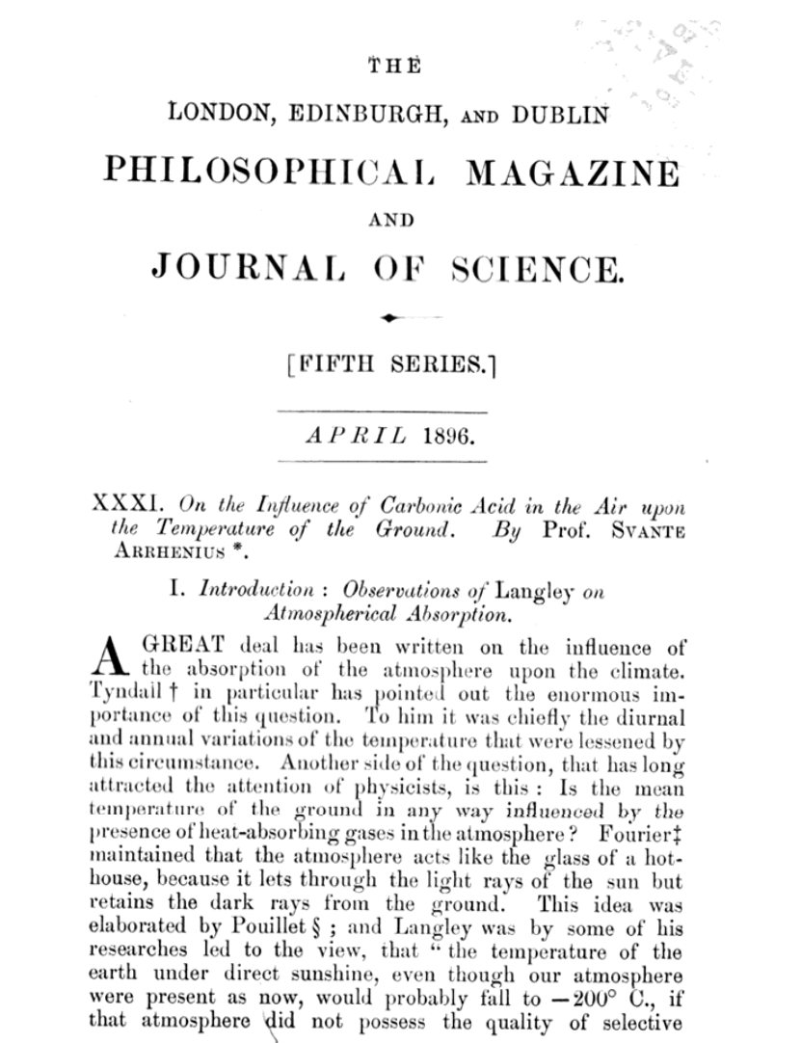
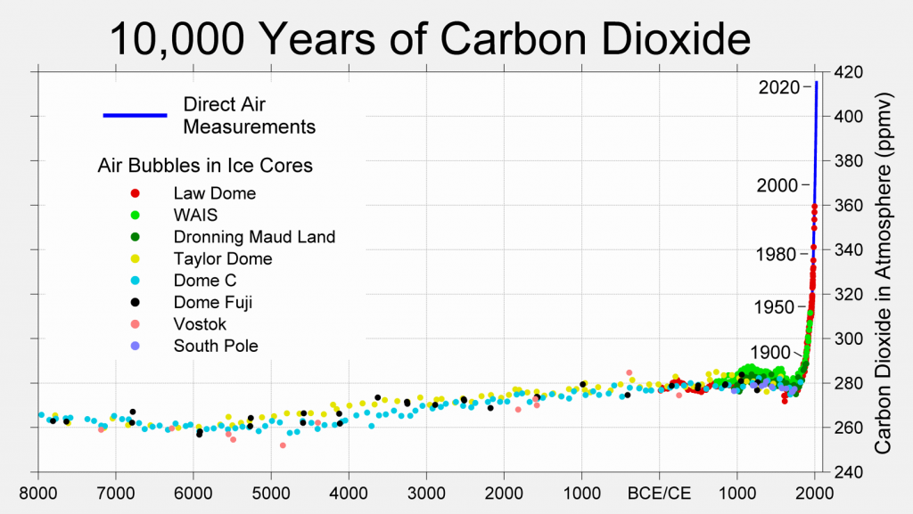
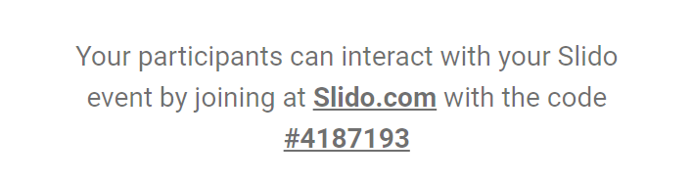
Carbon Dioxide and Climate Change
REDACTED
Notes:
So diving right into everyone’s favorite problem - climate change. I’m sure we’ve all seen versions of the graph here on the left showing the increase in carbon in our atmosphere as well as the temperature increases that we’re seeing.
Now before we go any further let’s play a fun game. On the right here is the first paper that makes a link between carbon in the atmosphere and temperature on the ground. And I would love everyone here to guess what year do you think this paper was written in?
A lot of people myself included are surprised to hear that this happened so early. And from what I understand the scientific consensus around this point of view emerged in the early 1900s. Since then the only real debate has been around how long this was going to take and how impactful the effect was going to be. In a big way the physical sciences solved the problem of climate change about a century ago. So why do we still have this problem?

Slide 5
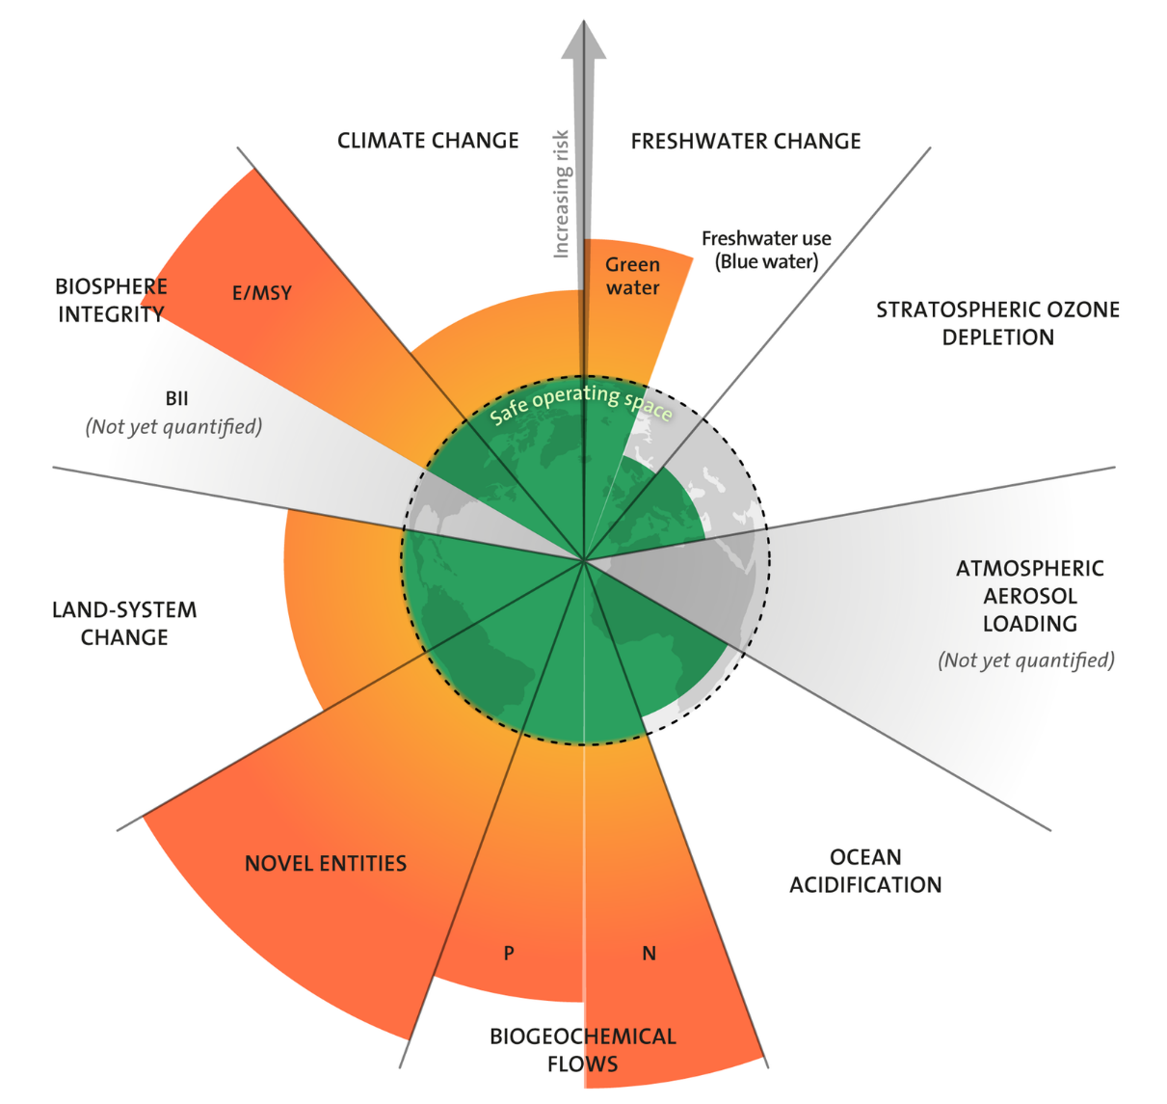




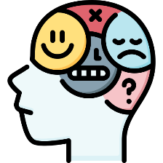

Complexity of problems
Climate
Politics
Economics
Institutions
Psychology
Engineering
Notes:
And the reason for this is the problem is not that simple. We can’t just turn off all fossil fuels because that’ll totally crash our economy and that will hurt even more people. But to understand economics you need to understand how people behave and that leads you to questions about the engineering and design of our society which leads to questions about access to health and resources for people which leads into global politics where there’s a bunch of humans gobbling and nothing gets done which is why we can’t solve our climate problem. There’s no nice neat solution that we can have here because when we start looking at it we realize that everything is connected to everything else in a kind of global society and that changing one thing will lead to cascading effects and other things and we may end up in a worse position than where we started.
If we look into it more we actually see the air temperature aspect of climate change is only a small piece of the puzzlethat biodiversity wants chemical pollutants and the phosphorus and nitrogen cycles are more pressing issues. And it’s really hard to solve any of these because we’re not just dealing with climate science here.
Novel Entities = Environmental Pollutants (ex: microplastics, chemical waste)
Biosphere Integrity = Genetic diversity (absolute [measured] & functional [unmeasured])

Slide 6



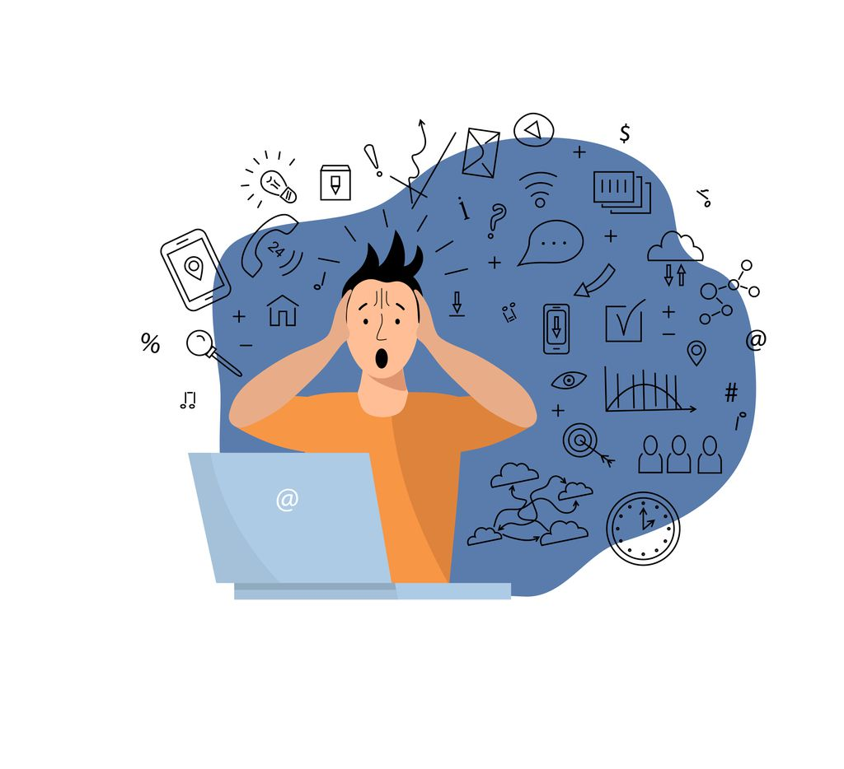
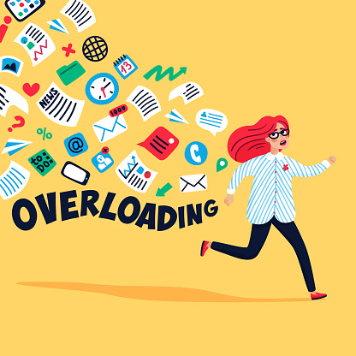
Information Overload
Notes:
And I think a lot of people have felt some version of this feeling you hear a lot when people talk about emails. They’re just too many things to try to keep track of – it keeps coming in faster than you can process it and so it builds up then slowly builds up until you feel like you’re drowning in it.

Slide 7






The Structure of Knowledge
Notes:
Why is it that we all feel this way?
I think one piece of the answer here is that the structure of knowledge has changed.
In the past, knowledge had to be transmitted through either people, or perhaps books, and this meant that knowledge was bound by location. You had to physically be in a specific place spatially in order to access a piece of knowledge. A result of this is that knowledge could only move as fast as people could physically carry it. Knowledge moved at approximately human speeds. But since the invention of electricity, this has all started to change. Suddenly information started to move so quickly that it effectively becomes instantaneous to human perception. And as we’ve iterated on this technology, we’ve expanded it’s access – where with today’s satellite internet – an average person can access the entire sum total of human knowledge from anywhere at anytime.
And this has opened up so many new possibilities. New opportunities for communication, collaboration, scientific advancement. And we’ve started to experience changes in our world and in our culture at a rate that humanity has never experienced before.
---
As an extension of this theory, which we can think of as “the medium is the message”, we can also take it and apply it to universities. Universities are knowledge institutions,
Knowledge is an evolutionary artifact which changes over time.

Slide 8







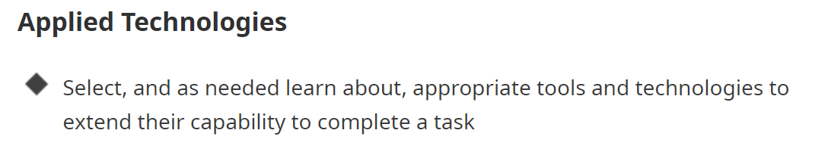


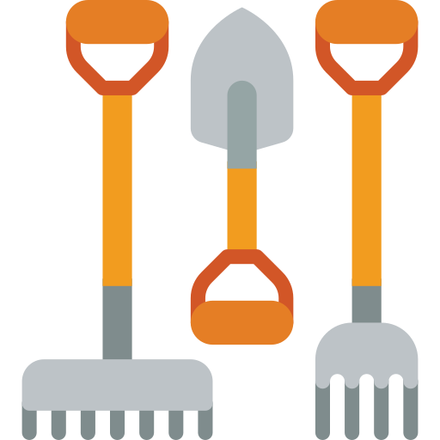


Humans and Technology
Extended Stomach
Notes:
Even though in our modern world we think of technology as meaning electronic computers -> ex: ‘tech industry’, this isn’t really accurate.
In fact humans have been using technology for our entire existence as a species - some people would say it is one of the fundamental things which makes us human. And if we substitute the word technology for ‘tool’ this becomes a little more clear.
One of the first tools that humans created and used was clothing. We would take pieces of the world around us - often other animals - and fashion them into things that we could wear to increase our ability to survive in different environments, or allow us to carry more things. Pockets and bags are a very underrated technology considering how useful they are. We did a very similar thing to increase our ability to hunt – crafting ourselves artificial armor and claws.
We’ve done similar things with other tools like shovels or rakes. And we do it every day inside of our classrooms as well. We use scissors to cut things in ways that we couldn’t with our hands. We use pencils to be able to leave marks on our environment, allowing us to remember things or communicate with others in ways that we can’t using our body alone.
All of these things which I’ve just shown you are ways that humans have used technology to alter and enhance the physical abilities of our bodies.
Interestingly, this technology use has actually come back around and affected our bodies as well. Humans have one of the weakest digestive systems out of any animal. We don’t have strong jaws, and if we ate things the way other animals did we would almost certainly get sick. And yet, we have the widest variety of food sources out of any animal. How is this possible? (would anyone like to guess?)
The answer is - we don’t eat things the way other animals do - we use fire and heat to cook our food, cleaning it of harmful bacteria or substances. We also use things like knives to cut and crush food externally, so we don’t need to have strong jaws to chew it.
Because we’ve been doing it for long enough, cooking has affected our biology. We call this the extended stomach. You can’t understand the human digestive system without also understanding how we use cooking to extend and enhance that digestive system. The cooking IS a part of the digestive system, even though it happens outside of our bodies.
And this language of extending our abilities isn’t an obscure academic term either. This is a screenshot that I took directly from the BC grade 6 ADST curriculum.

Slide 9
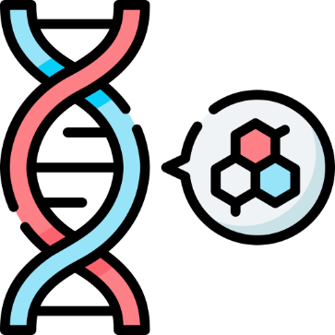



Co-evolutionary systems
Biological
Environmental
Cultural
Technological
Notes:
When we talk about systems which evolve together, we often think of biology and the external physical environment, where as one of these things change the other will tend to change with it – we call this the phenotype of an organism and it can be seen a lot in nature vs nurture debates.
But with humans, things get a little more complicated. We also have cultural influences which affect how we behave, who we desire as partners, and what physical structures we build.
And we also have technology, which has huge impacts on our culture – just think of the internet. Fossil Fuel technology is having a profound negative impact on our environment. And as we saw with the extended stomach, some of our oldest technologies have even had time to affect our biological structures, and with new tech like gene editing we may even start to see large biological impacts within single human lifetimes.
So we have, and have had a profound connection to, and reliance on artificially created technologies for as long as we have been human. And this is what makes us a “cybernetic organism” – we are part technology and part biology.

Slide 10
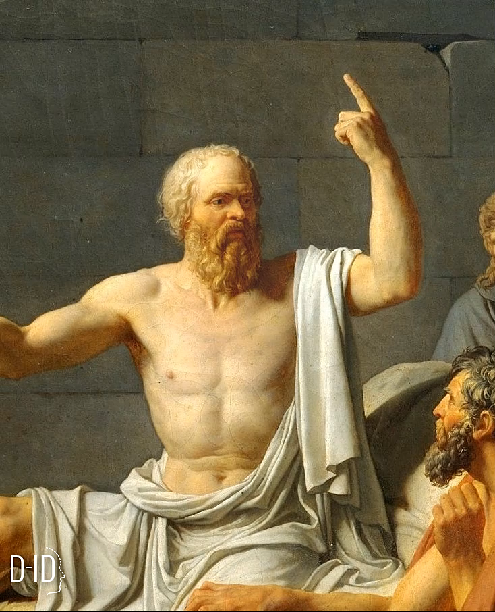
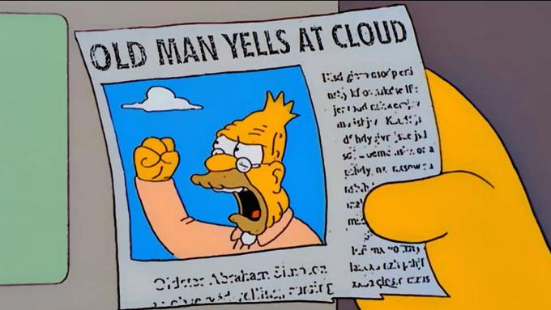
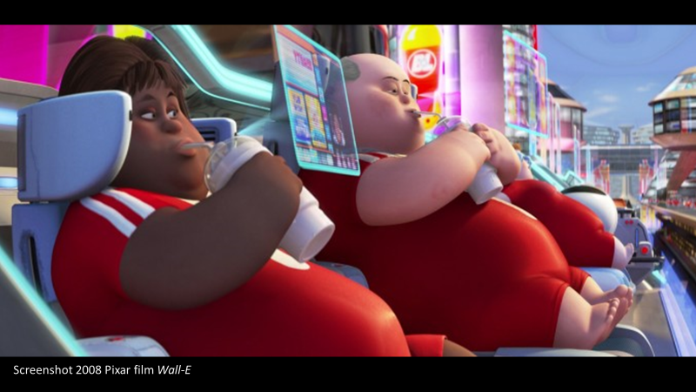
“The discovery of the alphabet will create forgetfulness in the learners' souls, because they will not use their memories; they will trust to the external written characters and not remember of themselves... You give your disciples not truth but the semblance of truth; they will be heroes of many things, and will have learned nothing; they will appear to be omniscient and will generally know nothing”
- Socrates, ”Phaedrus”
McLuhan, M., & Fiore, Q. (1967)
Notes:
And to argue this point, I will let Socrates speak for himself.
Here Socrates is voicing his concern that people who were using written text to understand and remember things, haven’t really learned that thing.
And I bring up this argument for two reasons:
1) I want to poke fun at it a little bit. It’s basically a time honored tradition for older generations to complain that younger ones are over-reliant on whatever the new thing is at the time. And it’s incredibly amusing to me that the only reason we can remember Socrates didn’t like writing… is because his students took the time to write down his words.
2) But on the other hand, I believe there is a valid concern in here. It is possible to take this too far – Wall-E is a great movie that explored this, where the humans on their spaceship are basically infantilized by the ship’s computer – they are completely incapably of thinking, or even moving independently.

Slide 11
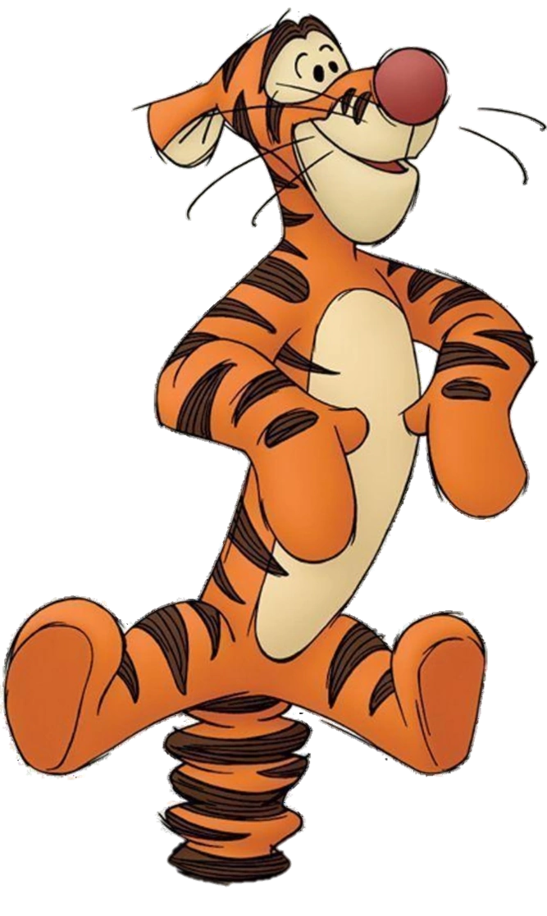
Why do we write?
Imagine a Tiger
How many stripes does it have?
Notes:
So maybe we can continue to another question - why do we write?
We’re going to start by have everyone close our eyes.
Try to imagine a tiger
Add details (paws, eyes, fur, stripes)
Think: How many stripes does the tiger have?
*pause*
What happens to your mental image of the tiger when you ask that question?
Probably was difficult (warped, changed, disappeared)
*show picture*
If we had drawn a picture of our tiger, this would have been a trivial question to ask -> could just count the stripes. But holding it in our heads made it difficult or impossible to do so.
This tigger has 34 stripes
The medium in which we do our thinking affects the content of the thought, and can determine what questions we can ask and answer.
What we can do when we imagine something in our head is different than what we can do when we represent things using an external tool.
George Orwell - “If people cannot write well, they cannot think well, and if they cannot think well, others will do their thinking for them.”

Slide 12
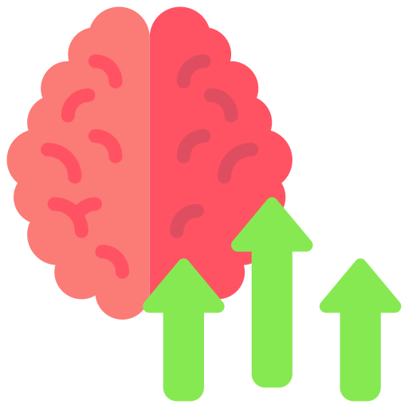


Writing as technology
Writing as a medium for thinking
Notes:
So I think it’s worth thinking about writing as a technology. When you think of the word technology, writing with a paper and pencil is probably not the first thing that comes to your mind. But while writing is not new or flashy like an electronic device might be - It is an external tool, which was invented by humans as a way extend and enhance our ability for thinking. Arguably it is one of the most powerful tools ever invented for enhancing our thinking skills. Externalizing our thoughts allows us to work on them more later on - it’s a way to link together our thoughts through time, and link our thoughts to other humans. In computational terms, we increase our memory capacity, and link computation across time -> making us and our brains into more powerful computers that can solve harder problems.

Slide 13
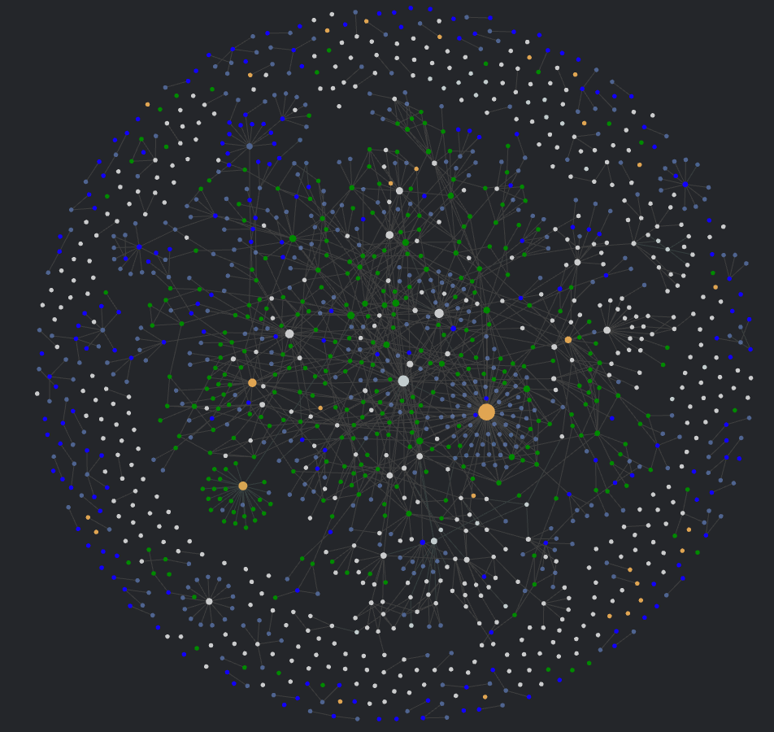
Linked Note Taking
“Smart Notes”
Organization
Folders -> Direct links, tags
Process
Blank Page -> Writing starts with notes and sources
Notes:
What I want to talk about now is my proposed solution to this problem. How is it that educators can actually teach and evaluate the process of writing?
My solution to that is a type of writing which I like to call linked note taking, or linked writing. A lot of people have started calling this process “smart notes”. I dislike that term because I read it and have no idea what it means.
Linked Note Taking is special in two ways.
First, it moves the primary way of organizing writing away from folders, and into direct links and tags
Second, It considers the writing process to begin much earlier than we typically think, where writing does not begin at the moment you sit down to write your essay, staring at this blank page and not sure where to start. It considers writing to start from when you are reading or listening to sources, and making notes on those sources, and then draws continuous links at every step where you are building up your thoughts and connecting your thoughts slowly, before you finally arrive at the point near the end, where you actually try to organize all these thoughts into a linear format - something like an essay.
I’ve been doing this process for about 3 years now and you can see up on the screen an image of what my my vault of notes looks like, with all the connections between them.
This is a subset of my notes that I filtered so that I could fit it in an image, because there are close to 2000 of them.
Full vault -> 1900 notes
600 -> journals
300 sources
350 notes

Slide 14

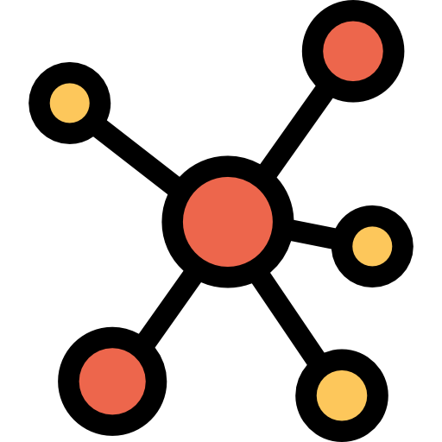

Organizing information
Files & Folders
Backlinks
Tags
Notes:
So how does this Linked process work?
First I’ll mention the organization and how it differs. Traditionally we use a files and folders structure to organize information. This works well when you have a physical copy of information that can only be referenced in one place, and it’s an evolution of how we used to store pieces of paper physically. But this way of organizing has some drawbacks, most notably that information can only be accessed through that one place where it is stored and this is mutually exclusive - we have to pick a single place, not 2. But we often store that information based off when or where we learned something. An example would be “I learned this in my UBC psych 101 class” so I would put in in the UBC folder, and then maybe the year, then the class psych 101. But then say later on I’m learning about Artificial Neural Networks, and that reminds me of biological neurons, and I have a vague memory that I learned it in a class? Maybe a psychology class? And even with digital search, it’s prob going to take me some work to find that one lecture in my psych 101 class that talked about it.
Another way of organizing information is backlinks. You can think of these as being the same as links on the internet, but they go both ways. And so in the neuron example what I might have been able to do, is that while I’m taking my psych class I might have linked to a note called Neurons, then later when I’m learning about artificial neural networks I might be reminded of neurons and also link to that page. Then, because my link points forwards and backwards I would be able to follow it to the pysch lecture which I linked a long time ago. This might seem a little confusing right now, but hopefully it’ll make sense in the next slide and as we start doing it ourselves in a few minutes.
I also have Tags, which I can basically use as keywords which I can search and function exactly the same way they do on something like instagram or twitter. I don’t use these a lot, and they won’t be featured much today, but I wanted to mention them as existing.

Slide 15
Note Scaling
Files and Folders
Tags and Backlinks
Difficulty of searching & organizing
Difficulty of searching & organizing
Number of Notes
Number of Notes

Slide 16





The Linked Writing Process
Source
Source Notes
Concept Notes
Written Product
Notes:
How does this difference in organization fit into the writing process? And why should you as educators care about this? If we think about the writing process as starting with reading source, we’ll be able to create an unbroken chain from the source to the final product. It’ll create a visible and traceable record at every stage along the way.
So an example of what this might look like is that I start with my source. That might be a book, a video, a lecture, and then I make notes on that source. In something like a video that might mean writing down timestamps and your thoughts, but I think it’s really powerful with written sources because you can include direct quotations, and your thoughts at various points. And you’ll link these things together.
Next you will move on to more general concepts. And again you’ll link between your source notes and those concepts. This part of the process is very non-linear, it might happen over the course of months or years, but what you’ll end up with is notes about concepts or subjects, which also have a complete list of all the sources you used to form those concepts.
Finally, you might have something like an essay, where you are then taking a bunch of concepts and organizing, ordering and filtering them, and ultimately ending up with a linear written work. And what you’ll notice about this is that there is this chain from source to product. There is a written record of the evolution of thinking which you can see by tracing back the links from the product all the way to the source. So this is not only a great way to help you write better, but also gives a way for a teacher to assess the student as they went through the process. And you can’t fake the product by just giving it to an AI to write it for you, because it won’t include the links back to concepts and sources. Even if you tried to use AI to generate the content, you would basically be forced to treat it like another source, and go through the writing and link it to different concepts.

Slide 17
Creating a note taking system…
Open up obsidian!

Slide 18
Making Descriptive Links
Often, more specific descriptive titles are better!
Ex: Instead of Generative AI write something more descriptive, like: Generative AI forces educators to assess the writing process more than the product or Generative AI raises the floor for expectations about student’s writing abilities

Slide 19
You don’t always have to fill in a note
If you made a descriptive title like:
Generative AI raises the floor for expectations about student’s writing abilities
You may not need to explain yourself fully in your note as you are making it, as the title already describes much of the idea.
Think of them like interconnected jot-notes
It’s only when writing the final product that you have to fill in the gaps

Slide 20
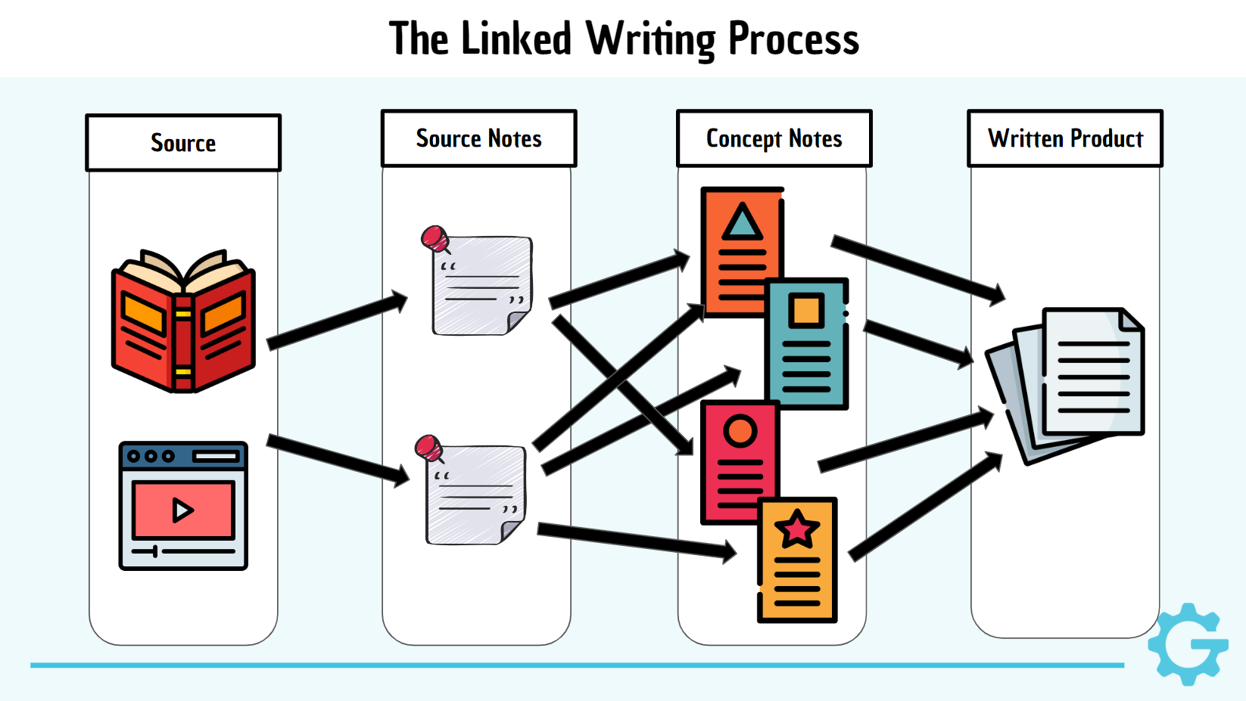
Chunk your writing!
Breaking the process down into
Source → Notes → Concepts → Product
Can make writing feel easier, as it gets broken down into smaller, more manageable chunks
This can really help with anxiety when writing!

Slide 21
Making Source Notes
Writing notes on sources is one of the most important habits to build
It gives support for your ideas, making you more convincing
It makes it easier to provide proper credit and avoid plagiarism
It forces you to actively engage with content instead of passively consuming it
This can also help reduce anxiety. We are constantly overwhelmed with information and it often feels overwhelming. Adding more action and less mindless consumption helps with this.

Slide 22
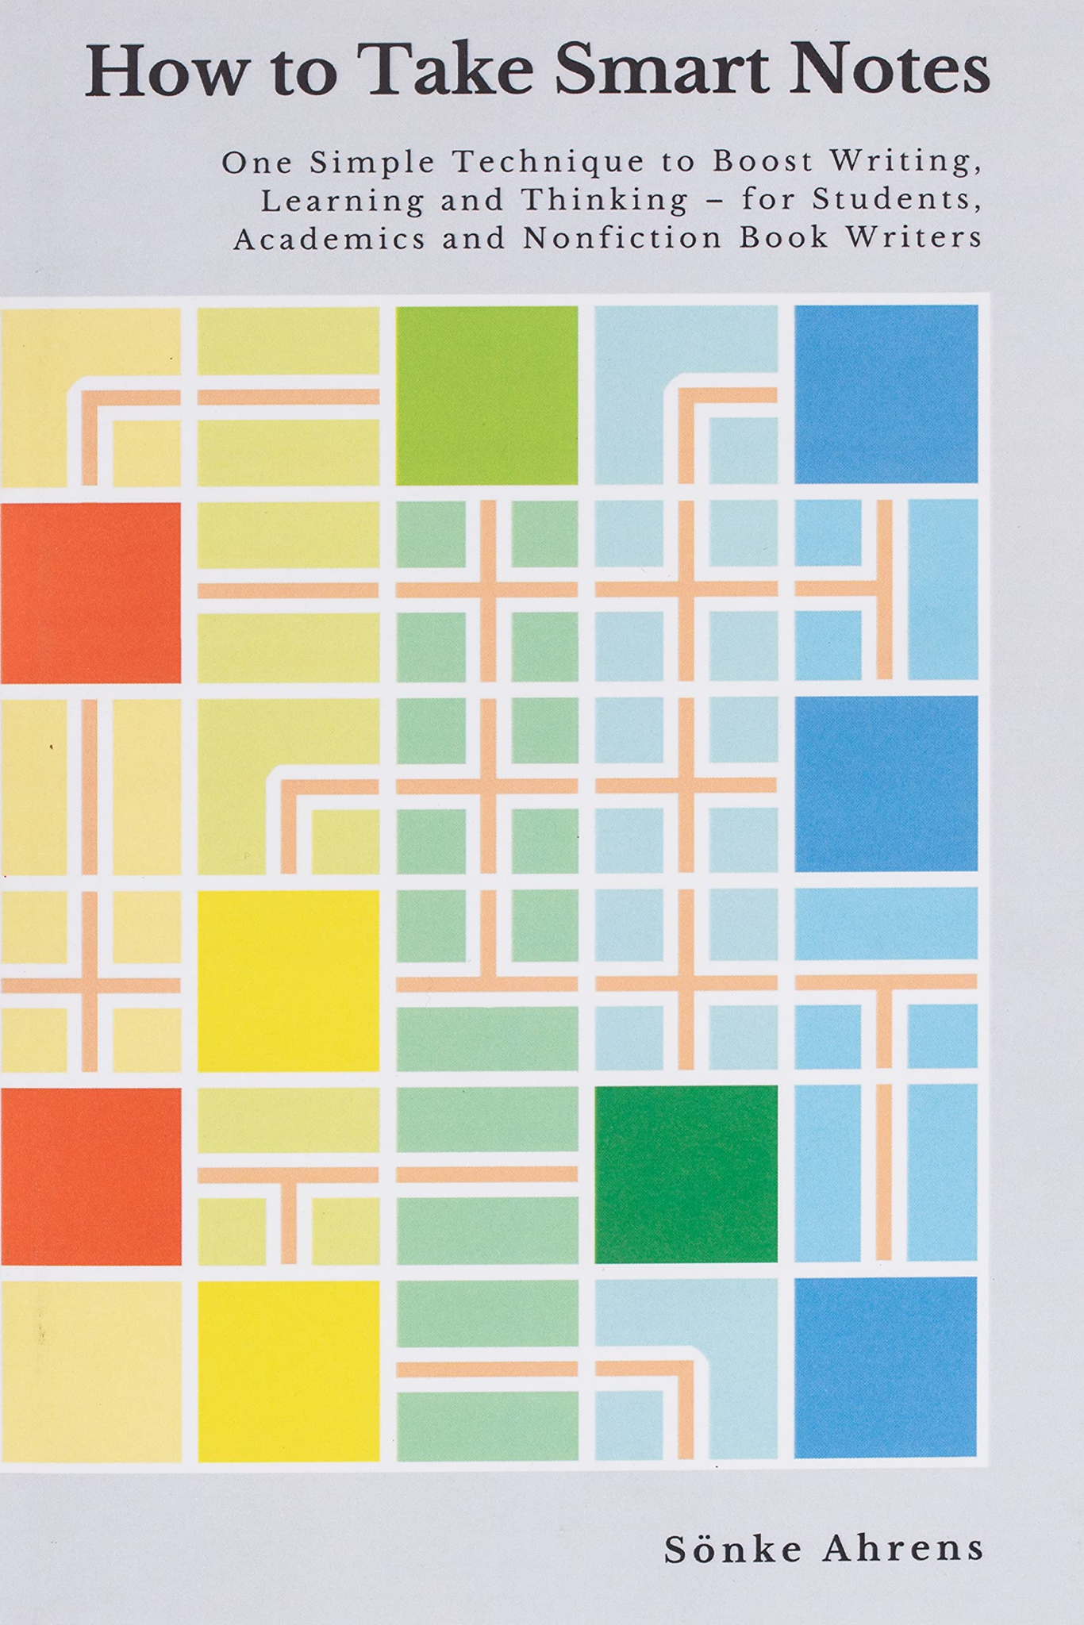
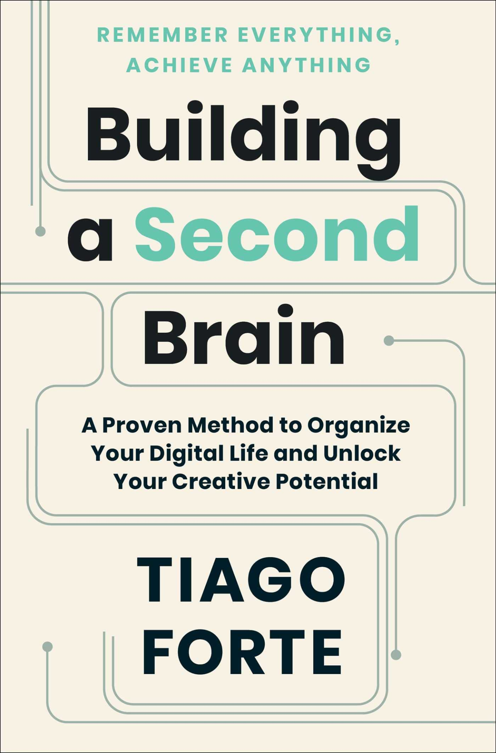
Information on Linked Note Taking
Alternate Terms: Smart Notes, Personal Knowledge Management (PKM), Zettlekasten

Slide 23




Technology for Smart Notes
This is THE most important choice to make → changing systems is difficult

Slide 24

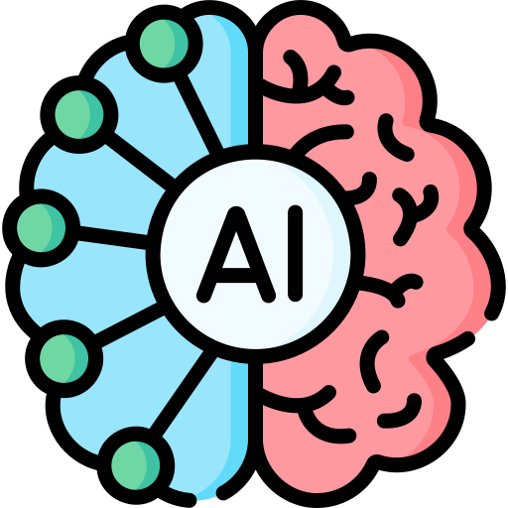
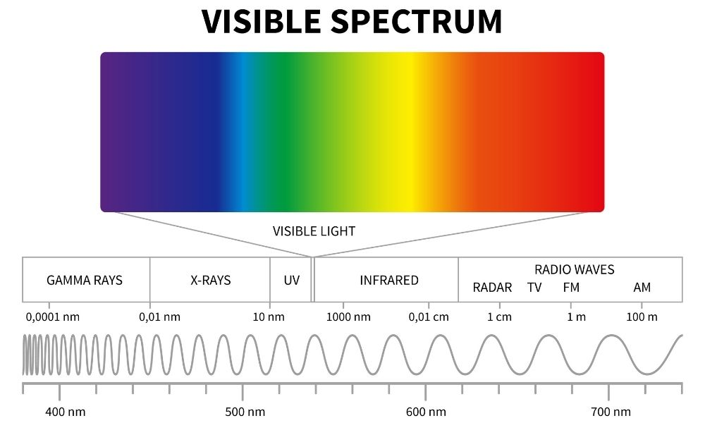
Augmented Intelligence
Notes:
In fact, I think it’s helpful to zoom out even further and ask: What purpose do computers serve?
Humans have been using technology to augment the abilities of our bodies for millennia. But one very common way we have of doing this in modern society is the use of glasses to help people see.
But we’ve also taken this idea of using technology to help us see and extended it further. We have realized that the visible light we can see is only a very small part of the broader electromagnetic spectrum. And through the use of machines we have been able to augment and extend our senses to be able to detect and manipulate other wavelengths along this spectrum. We used technology to augment our physical abilities.
In a similar vein, humans also create technology to augment our cognitive capabilities. For example, we use writing and books as a way of helping us remember information, structure our thoughts, and communicate with other humans without using sound waves, which has allowed us to gradually accumulate and communicate knowledge across vast stretches of time and space. Computers do something similar – they allow us to augment our thinking and solve problems which would be effectively impossible for a human to do in a reasonable timespan. With the recent advances in artificial intelligence, and things like large language models we’ve taken this same idea, but made the computer much easier to use by allowing it to communicate in natural language that we find easier to understand as humans. But with these advances has come a lot of fear and uncertainty. Is this technology going to replace us? This is why I’ve come to like the term ‘Augmented intelligence’ instead of ‘artificial intelligence’. I think this more accurately describes how humans create technology to augment ourselves, and it also recenters the focus back to the human instead of on the computer. It more naturally leads to questions like “how does this help and enhance human abilities and wellbeing?” rather than “how does this replace human abilities?”.

Slide 25
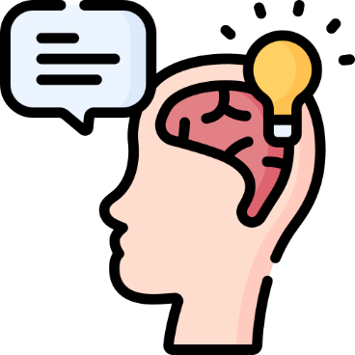


Transparent Technology
Do You Know It?
Finding the Time
Person A: Do you know what time it is?
Person B: Yes! (checks wristwatch) It’s 10am.
Consciously Accessible → YES
Research/Look Up → NO
Clark, A. (2010). Natural-born cyborgs. Oxford Univ. Press.
Notes:
One of the main questions surrounding technology in education is to ensure the fair assessment of student ability. What technologies should be allowed? What should be considered cheating? Under the surface, this question is a philosophical one: what can we say that a person “knows”. A rule of thumb which we often use here is that if knowledge is immediately consciously accessible to a person, then we say they know it, and if it would require them to look up or research that information somehow, then we say they don’t know it.
But technology can make this rule a little fuzzy – Andy clark has made an interesting observation surrounding our language use when asked if we know the time. When asked this question, someone will often answer that yes, they know the time before they look at their watch. Using a wristwatch is easy and accessible enough that we don’t consider checking the time to be an external thing that we have to look up. The technology has become transparent, in that we think through it and consider it to be a part of our cognition, or a part of ourselves. And we do similar things with other technology as well – clothes, cooking, glasses, writing, increasingly smartphones – all of these are artificially created technologies which over time have become increasingly transparent. We don’t notice that we are using them, and instead treat them more as extensions of ourselves. In the cognitive sciences this is the theory of extended cognition.

Slide 26
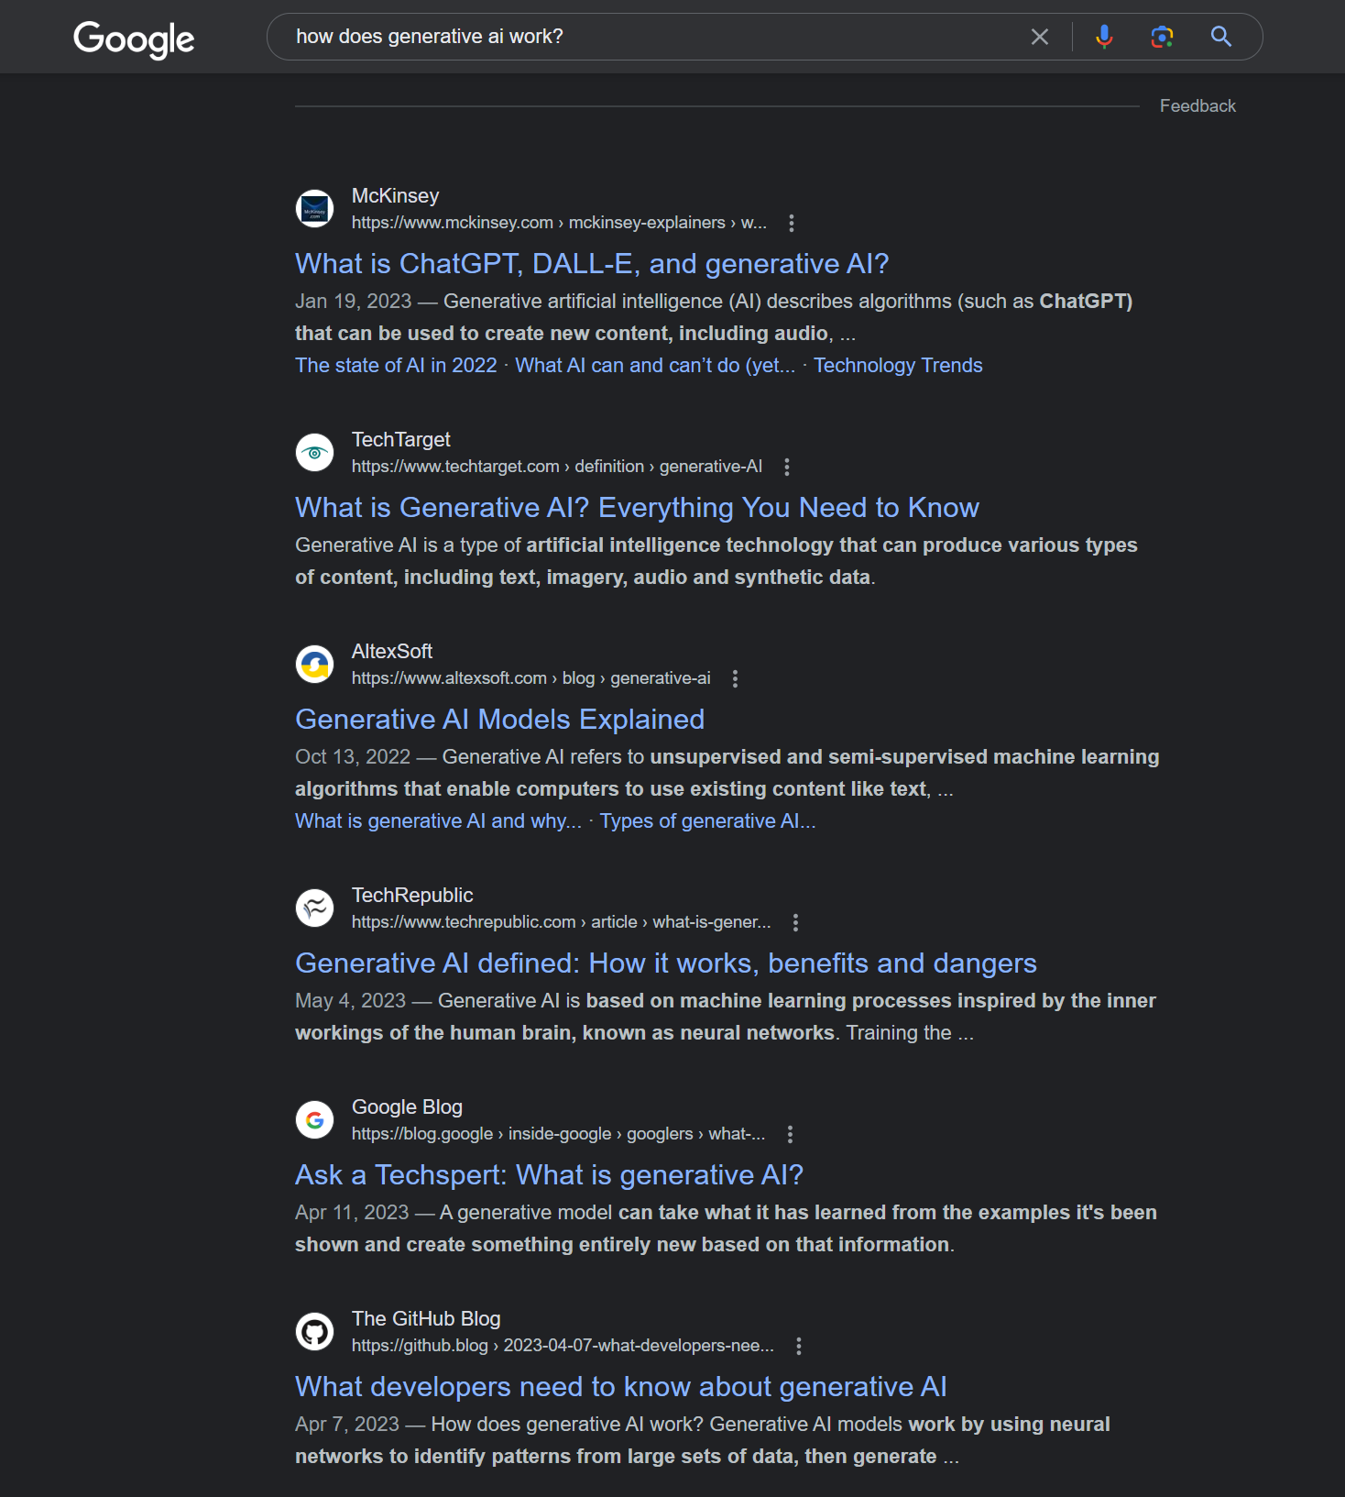
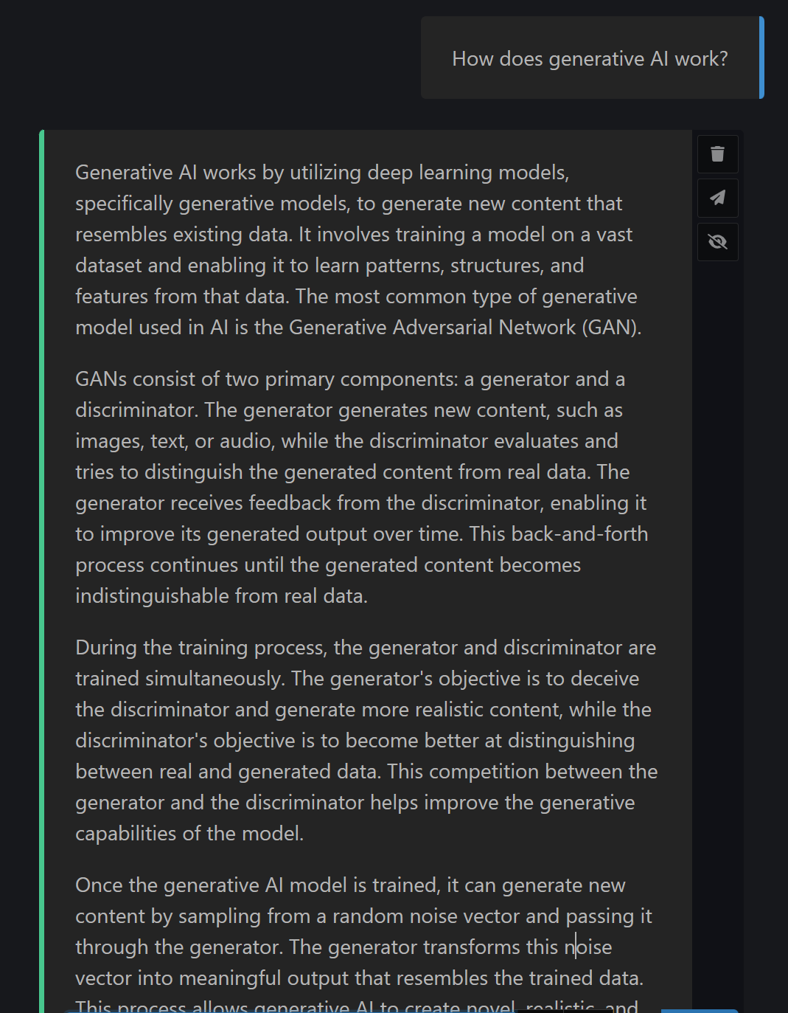
Transparent Technology
Searching the Web
Using ChatGPT
Notes:
How does this idea of transparent technology relate to AI?
It seems very intuitive to say that if you need to look something up on the internet, you don’t know it. And I think that a part of this is because when you search for something using Google, you often aren’t given an answer right away – instead, you are given something resembling a research project.
But language models change this. When asking a question, you are immediately given an answer to your question. It is much easier and faster to use than google search. It is a much more transparent technology.

Slide 27

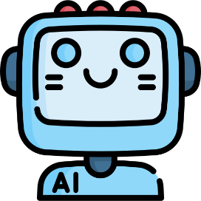

Continuum of Cognitive Aids
Less Transparent
More Transparent
Notes:
In fact, we can think of the entire history of computers as being the development of increasingly transparent cognitive aids.
So I’m beginning to wonder if the entire approach to determining a students ability through separating them from their cognitive aids – like their computer – is the wrong approach. As our technology gets more transparent, more embedded into our lives and into our selves, this line between what is human and what is artificial technology, will become increasingly blurry, and humans will begin to seem more like cyborgs.

Slide 28
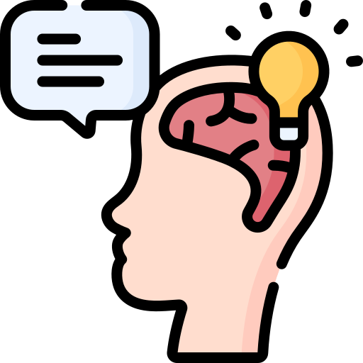
What year was the first climate change paper published?
Internal Memory
Could someone who uses this system be said to “know” the information?
Notes:
Now, I would like to propose the following thought experiment: Let’s say that a student
Sources:
https://news.mit.edu/2018/computer-system-transcribes-words-users-speak-silently-0404 https://www.youtube.com/watch?v=zA1rYccHcW4

Slide 29
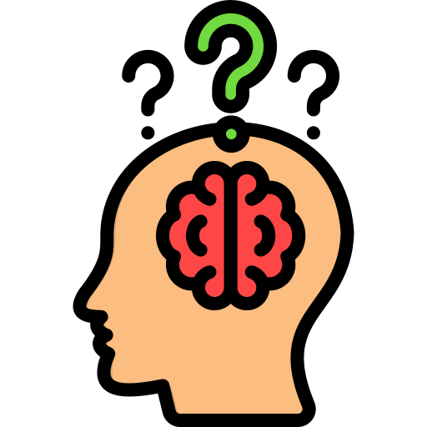

What year was the first climate change paper published?
Internal Memory
External Resource
Could someone who uses this system be said to “know” the information?
Notes:
Now, I would like to propose the following thought experiment: Let’s say that a student
Sources:
https://news.mit.edu/2018/computer-system-transcribes-words-users-speak-silently-0404 https://www.youtube.com/watch?v=zA1rYccHcW4

Slide 30
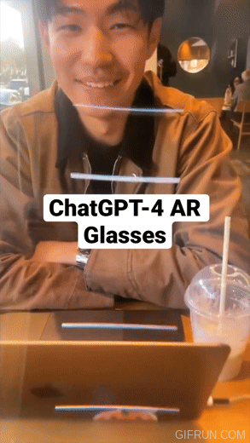
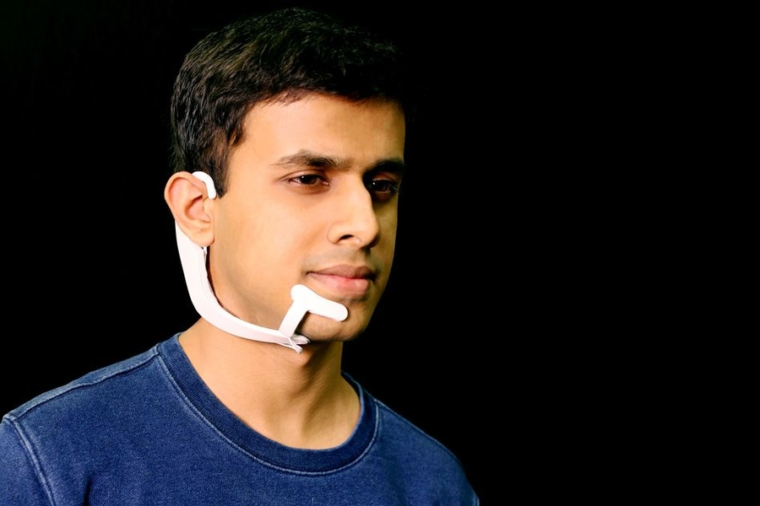
What year was the first climate change paper published?
Sub-vocalization Microphone (MIT)
Could someone who uses this system be said to “know” the information?
Notes:
Now, I would like to propose the following thought experiment: Let’s say that a student
Sources:
https://news.mit.edu/2018/computer-system-transcribes-words-users-speak-silently-0404 https://www.youtube.com/watch?v=zA1rYccHcW4

Slide 31
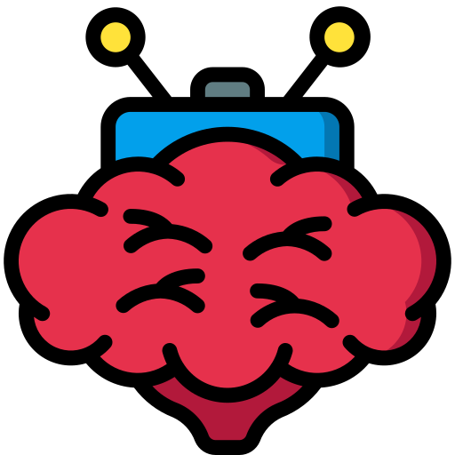
What year was the first climate change paper published?
BCI with Read + Write capabilities
Could someone who uses this system be said to “know” the information?
Notes:
Now, I would like to propose the following thought experiment: Let’s say that a student
Sources:
https://www.vox.com/future-perfect/2023/5/4/23708162/neurotechnology-mind-reading-brain-neuralink-brain-computer-interface

Slide 32

Hey, I solved climate change!
Yea but you used a computer, so it’s cheating and doesn’t count
Notes:
1) Use climate change as a specific example
2) Throughout our history we have used external technologies to extend our capabilities in both the physical and cognitive domains
3) Hope to give positive directions
I’m just a dude with some slides – I feel like I’m still very much in the process of learning everything I’ll be discussing here. What I hope to offer you today is not the final word in an argument, but rather an interesting and useful perspective or set of frameworks which can be used to analyze and view our problems, and hopefully provide some directions for productive paths forward.

Slide 33
Trajectory of LLMs
S curve of technology
Hardware & Software improvements
Tool Usage of GPTs
Technological Limit
C
Capability
B
A
Time
Notes:
Education is an inherently future oriented field, so when we think of new technology we can’t only evaluate its impact based on what it looks like now.
Technological development typically follows an S curve, starting with a proof of concept (Area A), followed by rapid innovation (Area B), and finally reaching a stage of minor improvements (Area C).
Generative AI currently feels like it is leaving area A and just starting into area B. There is a lot of room for further improvements with both hardware and software. Things like speed and the reliability of answers are technical problems which have already seen rapid and large improvements, and we should expect further improvement with time .
Additionally, language models can produce computer code, which itself can be thought of as a kind of language. This means that it can do most things that a human programmer would be able to do with a computer, including complex mathematics, internet searches, and more, which addresses many of the complaints surrounding the mistakes that these models are currently prone to making.

Slide 34
The Future of Problem Solving
1) Finding
4) Reflecting
2) Defining
“A problem well-stated is half-solved”
- Charles Kettering
3) Solving

Slide 35
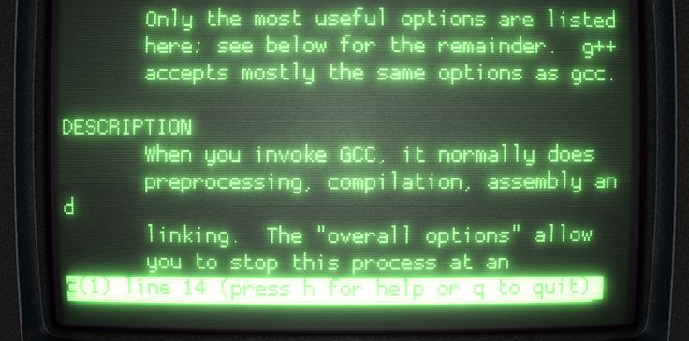
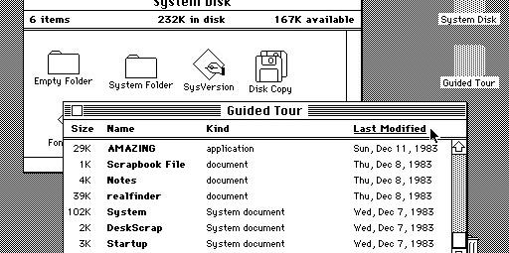
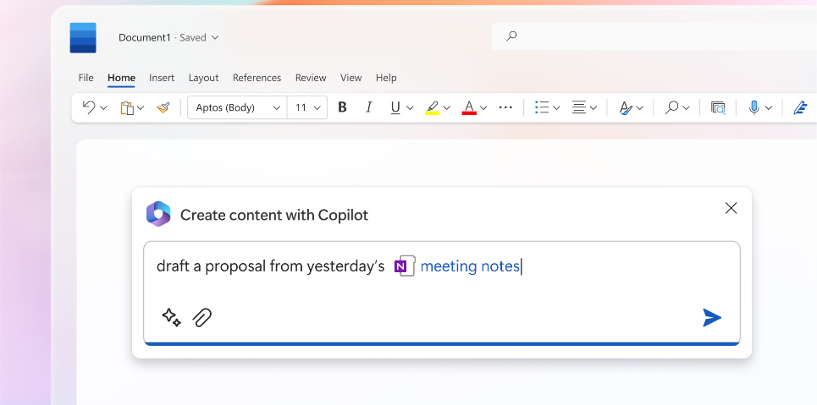
New Interface for Computers
Command line → GUI in 70s & 80s
AI interfaces today
Communications Skills
Interpersonal
Technical
Notes:
Okay, Last slide before we do our activity and you get to try all this!
The following is my opinion on how we should frame and think about this technology.
In the 1970s and 80s computers switched from having text based interfaces, where you controlled the computer by typing in specific commands, to graphical user interfaces, where you instead navigated through images and 2d space with a mouse. And this advancement radically transformed computer use in our society because it made them much more accessible, because you didn’t need any specialized technical knowledge in order to use them.
I think we’re seeing a similar thing happening again today. A lot of the functionality of computers is still gated behind technical knowledge in the form of coding that takes years and serious study to be able to use well.
This makes communications skills more important than ever. And what’s so exciting is that for so long technical human to computer communication skills have been almost entirely distinct and separate from human to human communications skills. But with generative AI like ChatGPT, computers are finally able to understand natural human language, and so if you are good at explaining a problem or a task to a human, it means that you can also be good at explaining it to a computer.
NOT essays
Being able to surface data through semantic search
Overlap between technical and interpersonal communications skills

Slide 36



What is AI Bad at?
Surprising
Social
Scarce
Roose, K. (2021). Futureproof: 9 rules for machine-age humans. John Murray.

Slide 37
Thank You!

Slide 38
Supplemental Slides

Slide 39
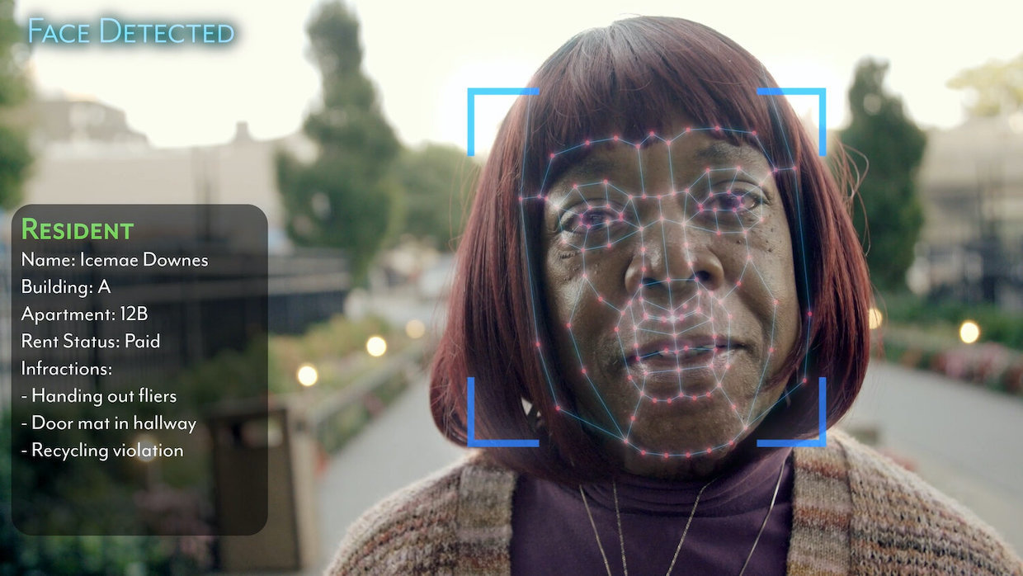
AI Bias
Intro / Generative AI / ChatGPT / Education / Trajectories / AI / Problem Solving / Risks / Opportunity / Conclusion / Outro
Representation Past → Future
Coded Bias (2020)
Notes:
Another kind of risk is of bias contained within these AI systems. This is a particularly difficult problem to solve, because you can’t ever completely eliminate all biases, in humans or AI. The best you can do is try to influence what biases do exist. We have to be biased in order to effectively sort through information and discern if it is worth listening to or not.
But the problem comes in when this bias systematically discriminates against certain groups of people.
One way this problem can manifest is through data representation. For example, when facial recognition systems were first created around the 2010s, they were terrible at detecting darker skinned or female faces. This was because the data set of images used to train these systems mostly contained lighter-skinned, male faces. AI can only learn by being given examples, and if we leave out groups of people from this example data, the system won’t perform well when it encounters these groups later on. And while facial recognition may feel like a trivial example, we have to remember that AI is being used for much more than facial recognition – it’s being embedded into and used all the time by corporations, as well as our critical societial institutions like finance, law, and education.
Another problem for biases in AI systems is that the data used to train them may itself be biased. Whenever we use data to train AI we are necessarily pulling information from the past and projecting the patterns found into the future. This can run a serious risk of taking past societal discrimination and encoding and locking it for the future. For example, if we are using AI in the justice system to help determine criminal sentencing or parole, we have to be aware that past juries or judges themselves may have been biased in their judgements, and taking that data uncritically can result in continuing discrimination into the future.
A silver lining in this problem though, is that AI is making visible many of the societal issues that used to be invisible. AI learns from humans and our behaviour, and it is very good at finding and learning patterns contained in data. In this way, AI can behave a little like a mirror for our own actions, and while this reflection may not always be flattering, it has started to highlight issues which may have otherwise gone unnoticed.

Slide 40
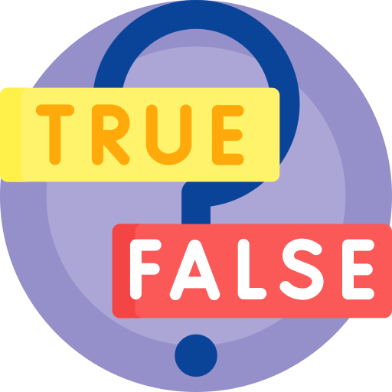
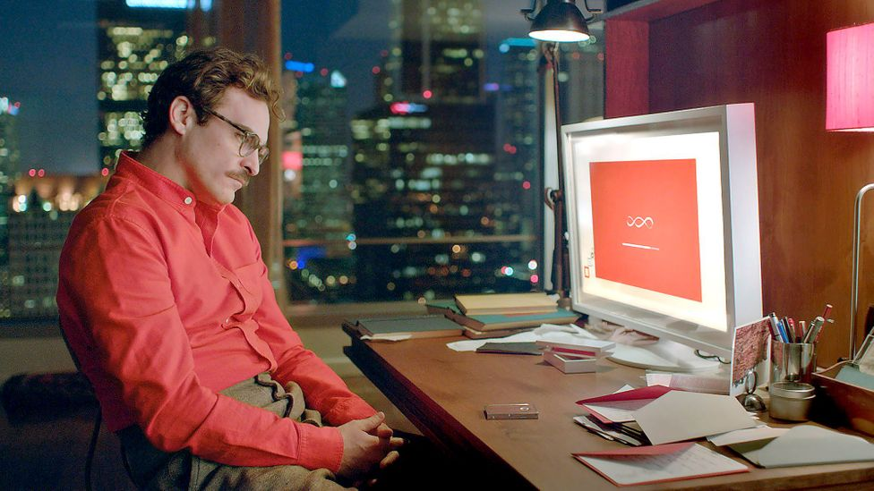
Synthetic Reality
Synthetic Relationships
Fictional worlds or information created so convincingly it seems like genuine reality
Social Media → Race for attention
Generative AI → Race for intimacy
Her (2013)
Discerning the true from the false becomes effectively impossible
Bots that say what we want to hear instead of what is truthful or good for us
Notes:
There are also some deeper risks that are associated with this technology. One of these is the ability to create synthetic realities. The ability for something like ChatGPT to impersonate users online at scale, along with other technologies like image generation and voice cloning, make it almost impossible to determine if a piece of information is real or artificially generated. We are already having a lot of difficulties surrounding misinformation on the internet, and finding reliable information can sometimes feel like searching for a needle in a haystack. It’s possible that this new technology could make the problem orders of magnitude worse, as we all become saturated in artificially generated content, shovelling in more and more hay to this haystack.
But there’s another, more intimate problem created by generative AI as well – synthetic relationships.
If social media was a race to grab and hold our attention, generative AI might end up as a race to grab and hold our relationships and feelings of intimacy.
Relationships of any kind can be difficult, whether they be platonic or romantic in nature. But it’s only through that struggle and failure that we grow and learn. And it’s not hard to see why someone might find an artificial companion to be a more attractive option because of this. But these bots may not act in your best interest. Unfortunately, there are a lot of incentives for those with power to lure people into these synthetic relationships. Political propaganda, or corporate advertising are a lot more effective if the information comes from someone who is a trusted friend or romantic partner.

Slide 41
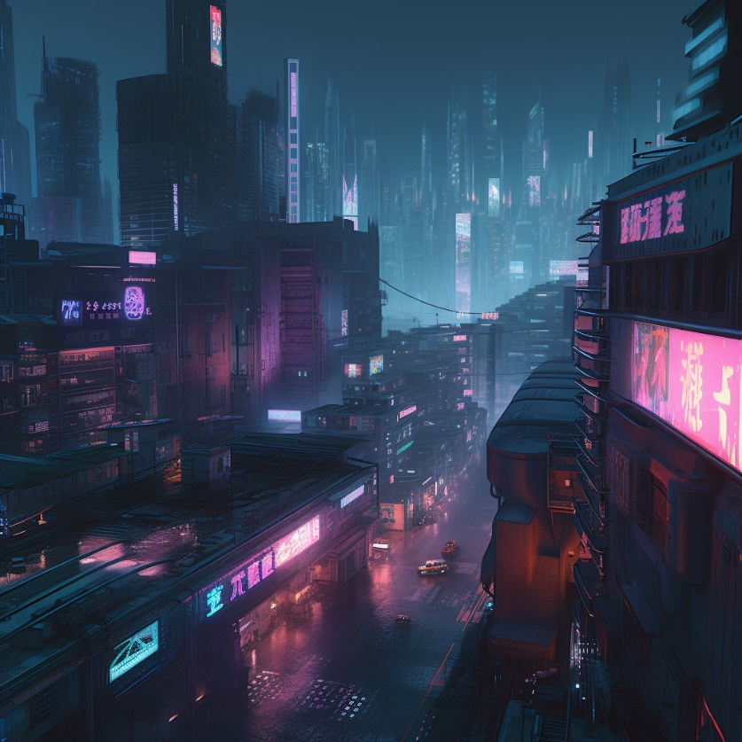
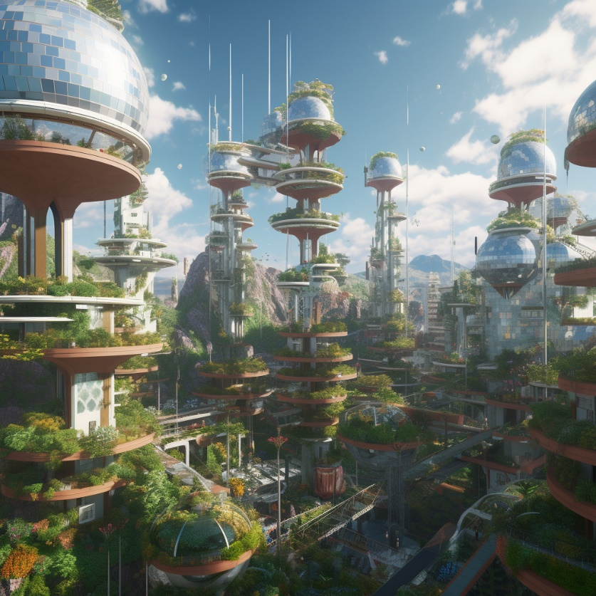
Our two Futures
“Cyberpunk”
“Solarpunk”
Notes:
So what we will specifically be doing is creating some kind of artwork which represents a positive vision of the future relationship between humans and technology. And I’ve included the word positive quite intentionally here. It feels like we are constantly being overwhelmed with dystopian versions of our future. And I believe that if the only thing we can imagine is cyberpunk dystopias that is what we will end up with. And so I want you to imagine today how you think things can go right.

Slide 42
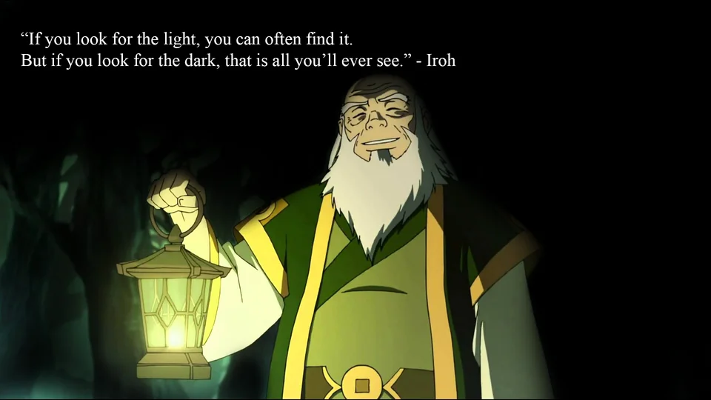
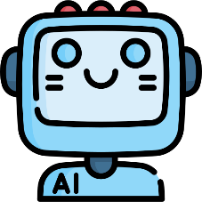
The Alignment Problem
Good for Humans
Bad for Humans
Notes:
Will this technology be good or bad for humanity?
Artificial Intelligence - or Augmented Intelligence, as I prefer calling it – is a powerful technology that is changing and improving quickly. Depending on if we can align this technology to human values and wellbeing will determine if this technology will have a positive or negative impact.
It’s not hard to imagine some of the ways that this could go poorly. You don’t have to look very deep into the Hollywood archives to find seemingly endless dystopian versions of AI.
But there are ways this can go extremely positively for us as well.
The real problem is if we get complacent, and say that something which has both positive and negative effects is ‘good enough’. With the pace of development that this technology is currently moving at, we may not have much time between when slightly bad effects start happening and very bad effects start happening.
I am not an optimist – I do not believe that good outcomes are more likely to happen by default. But I’m not a pessimist either.
Instead, I am hopeful. Hopeful that the capabilities of humans are great enough to rise to this challenge. I believe that the future is not pre-determined, and that the dystopian world we so often see in movies isn’t the only option available. With effort and intention, I believe that we can steer this technology in the positive direction. There is no guarantee it will work, and it will require us to relentlessly imagine ways that we can use this technology to improve the world, but I believe we can do it if we try.
If you look for the light, you can often find it. But if you look for the dark, that is all you’ll ever see

Slide 43


Sidebar: Detecting artificially generated text?

Slide 44

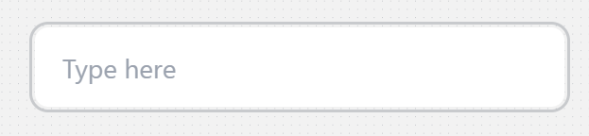



Generative Text as the interface
Notes:
See Generative AI in Higher Education.pptx (slide 43) for more context

Slide 45

Dangers
Synthetic Relationships
Synthetic Reality
Social Media → Race for attention
Generative AI → Race for intimacy
Fictional
Natural
Artificial
Physical
Bots that say what we want to hear instead of what is truthful or accurate

Slide 46
Algorithms
Algorithms
Artificial Intelligence
Computers which can solve tasks at human levels of competence
Machine Learning
A type of AI which can learn and improve from data/experience
A set of instructions that perform a specific task
Artificial Intelligence
Machine Learning
Notes:
Before we dive into things like chat GPT, let's first clarify what we mean by some of the terms
At the broadest level we have algorithms. Algorithms are a set of instructions which can be used to perform a specific task. You can think of a recipe to bake a cake as an algorithm.Though most commonly we think of algorithms as the code we write to give instructions to a computer.
Artificial Intelligence, or AI for short, is a computer algorithm which can perform tasks which would normally require human intelligence to solve.
However, usually when we think of AI, we’re talking about machine learning, Machine learning is a specific type of AI which can change its behavior from experience or data, meaning a human programmer doesn’t have to explicitly state every step of a problem.

Slide 47



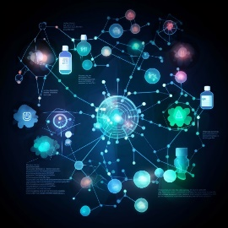
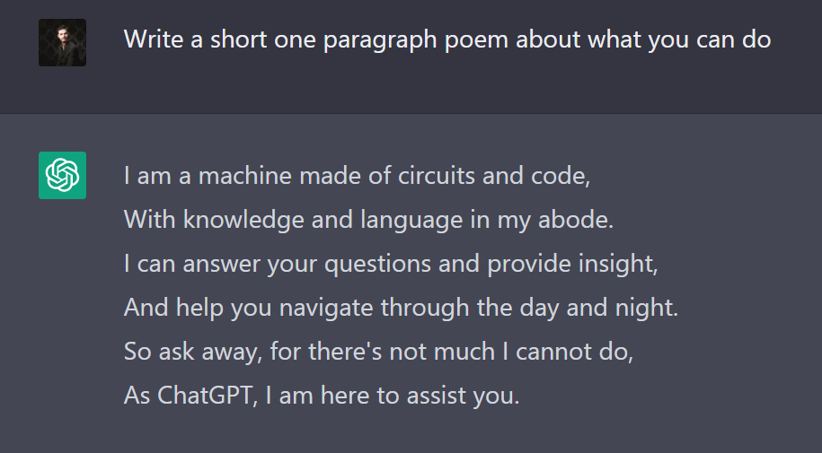
What is generative AI?
Predictive AI
Generative AI
Uses of Generative AI
Cat
Images
Sound
Cat
Design
Language
Notes:
So, before we dive into those opportunities and challenges, I’d like to quickly explain what chatGPT is, and I’ll do this by explaining the more general category of Generative AI.
It’s useful to compare generative AI all to Predictive AI. Both are first trained by giving them a large data set, for example a bunch of images, and then use machine learning to find patterns in that data. But where predictive AI can use the model created during training to categorize new data, generative AI uses it’s understanding to generate new data based on some kind of prompt.
This technology can be applied to various fields, from generating images, to synthesizing music or voices, to designing products and engaging in scientific discovery.
But for the educational world, it’s ability to generate text has caused concern, because of how much writing is used for assignments and assessment.

Slide 48

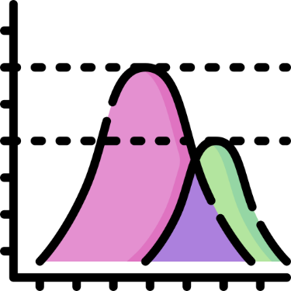

How does ChatGPT work?
Statistics
Relatedness
Feedback
Notes:
But in order to understand the impacts this technology is going to have on the world, and on education specifically, it’s useful to understand a little bit about how it works. Note that the following applies specifically to text generation, and that you would take a different approach for something like images.
And there are three main tools that something like chatGPT uses in order to understand and produce language in the form of text.

Slide 49



Relatedness
Statistics
Feedback
0.1
0.9
0.4
0.6
0.3
The cat sat on the ___
mat
floor
…
cloud
Notes:
The first of these tools is the use of large data sets and statistics. ChatGPT specifically was trained on an absurdly large amount of data – [INSERT STATS ABOUT BOOKS READ AND HUMAN READING TIME]
Through looking at this dataset, the model learns how likely different word pairings are, so it can start to predict which words are most likely to come next in a given sentence. If we take the sentence “the cat sat on the…” It would be able to predict that a work like “mat” would be very likely to come next. A word like floor would also be quite likely, and a word like cloud would probably not be very likely. You can think of this as being similar to the way that your phone
But there’s an additional piece here that adds a lot of the capability - It can also look back at past words and rate how much it needs to pay attention to them when guessing the next word. So in this example the word “cat” might be the most important, with the other words being less so. And it can look back across multiple sentences or paragraphs even, which is why it can stay on topic even when writing long responses.

Slide 50
Relatedness
Statistics
Feedback
A kitten laid on the cushion
The cat sat on the mat
The dog chased the stick
I enjoy eating chocolate
Notes:
Another piece something like chatGPT would use is the idea of relatedness. We’ve figured out ways to represent language as a set of numbers, and we can represent those numbers on a graph.
If we take the sentence “the cat sat on the mat” we could take those numbers and put them on a graph, like this. Then if we take a similar sentence like “the kitten laid on the cushion” and also put it on our graph it should end up quite close to our first sentence because they are quite similar in their meaning, despite sharing almost none of the identical words.
A sentence like “the dog chased the stick” is somewhat similar, but not very so it might get placed further away.
And finally a sentence such as “I enjoy eating chocolate” is completely unrelated and would get placed somewhere totally different.
ChatGPT would learn these related meanings through the use of statistics and lots of examples. And this is how ChatGPT can answer your questions – it can find the information which is similar in meaning. Now all this has been oversimplified, mostly because I’m showing it to you in 2 dimensions, instead of the several thousand that chatGPT actually uses, but the idea is the same.

Slide 51
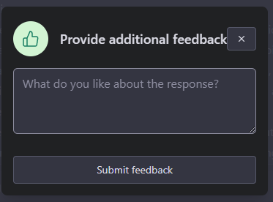
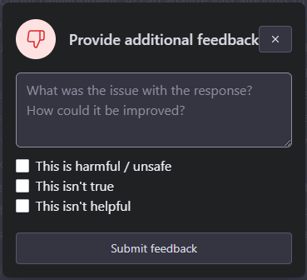
Relatedness
Statistics
Feedback
Notes:
Finally, we have human feedback. When you use chatGPT you’ll see the ability to leave a thumbs up or down whenever you get a response. This is called reinforcement learning, and it’s similar to how we train animals, where you might give a dog a treat when it does something you want it to, and give it a spray from a water bottle when it does something it’s not supposed to.
With machines this works a little differently. It’s more like the relatedness idea from the last slide, where it’ll change it’s response to be closer to desired inputs and further away from undesired ones.

Slide 52
ChatGPT
Artificial Intelligence
Statistics
Relatedness
Feedback
Notes:
Quickly, here is an oversimplified view of how ChatGPT works. First it looks at a large volume of text and tracks which words are statistically most likely to follow one another.
Second, it uses these statistics to estimate how close words are in meaning to one another.
Finally, it uses human feedback to help determine what kinds of sentences make sense.
https://youtu.be/ge8zRYmy4Yc

Slide 53
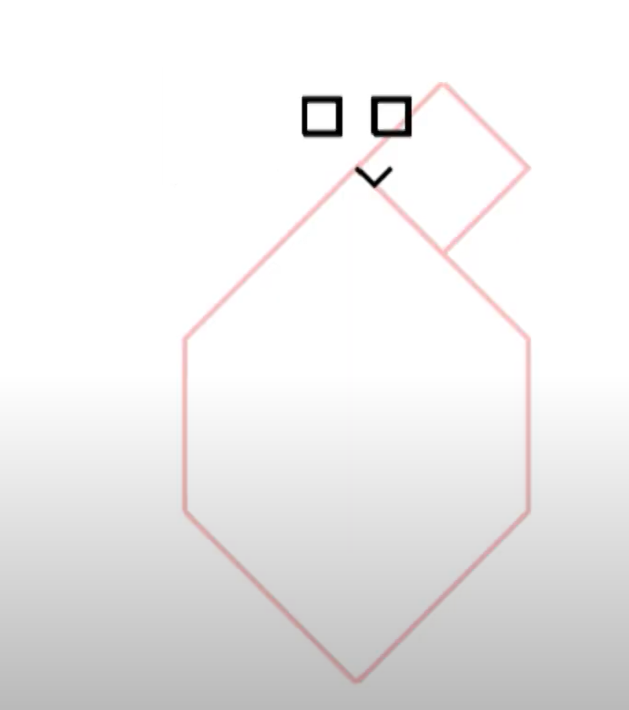
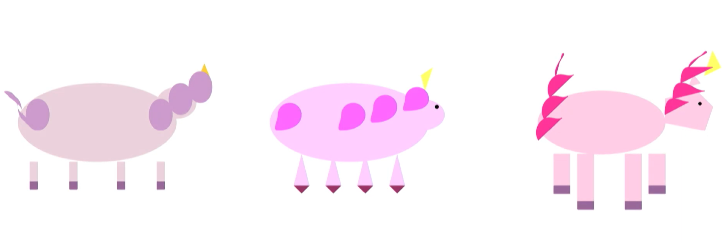
Improvements
GPT-4
GPT-3
Notes:
Safety has degraded this though

Slide 54
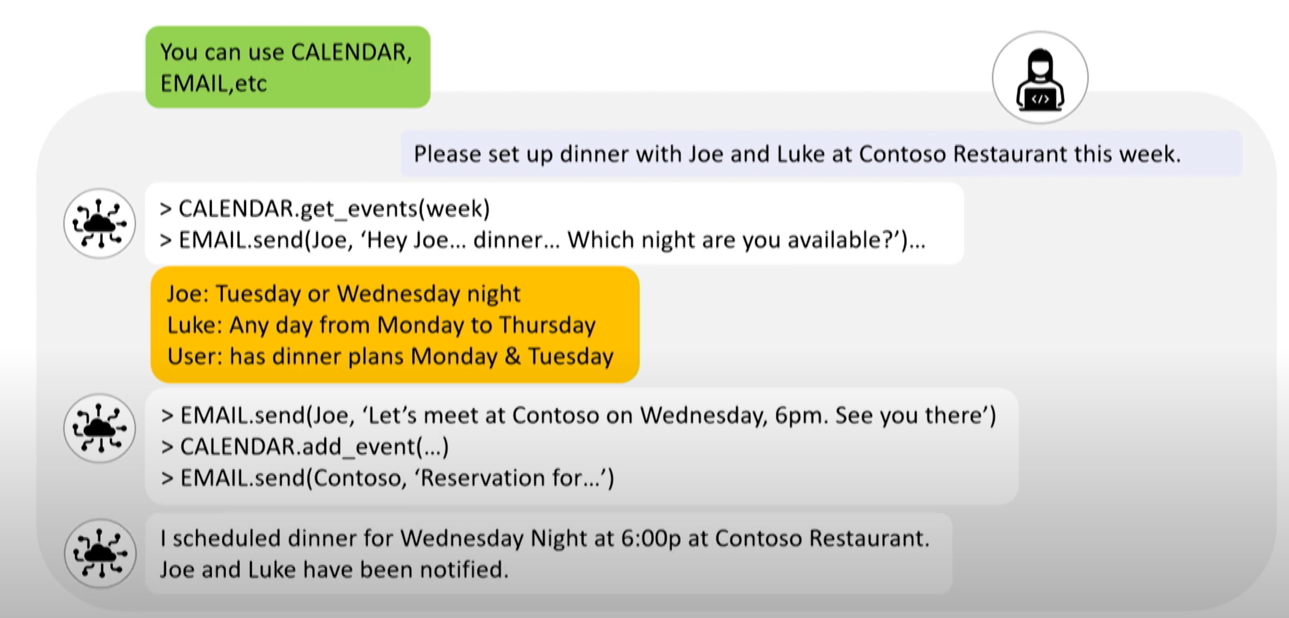


Affordances and tool use

Slide 55


Slide 56


Slide 57

The capabilities of machines
IQ Higher than average human
Bar exam → 90% percentile
GPT-4 is not human-like on everything, but everything it can do is human-like

Slide 58

Emergence

Slide 59

Notes:
V1 feb 2022
V5 mar 2023

Slide 60
The Alignment Problem
Good for Humans
Bad for Humans

Slide 61


Recommended Video

